Slide 1
Brute Force

Slide 2
Announcements
HW 2 due Fri
Lingering questions on alg analysis or HW 2?

Slide 3
What is Brute Force?
“Brute Force is a straightforward approach to solving a problem, usually directly based on the problem statement and definitions of the concepts involved.”
Notes:
Example: computing a^n by multiplying n times.

Slide 4
Why Brute Force?

Slide 5
Brute Force Sorting

Slide 6
Sorting
Sorting: given a list of n orderable items – e.g. numbers, characters, character strings – rearrange them in non-decreasing order.
How would you naturally tend to sort things?

Slide 7
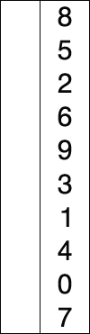
Selection Sort
SelectionSort(A[0…n-1])
for i ← 0 to n-2 do
min ← A[i]
for j ← i+1 to n-1 do
if A[j] < A[min]
min ← j
swap A[i] and A[min]
Basic Operation?
Summation?
Big Θ?

Slide 8
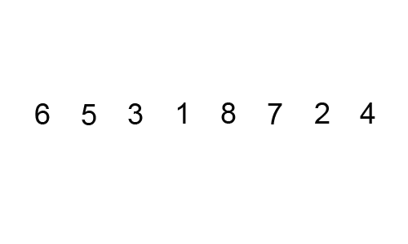
Bubble Sort
BubbleSort(A[0…n-1])
for i ← 0 to n-2 do
for j ← 0 to n-2-i do
if A[j] > A[j+1]
swap A[j] and A[j+1]
Basic Operation?
Summation?
Big Θ?
Improvements? Would Big- Θ change?

Slide 9
Brute Force Searching
What algorithm would be a brute force approach?

Slide 10
Linear Search
LinearSearch(A[0…n-1], K)
i ← 0
while i < n and A[i] ≠ K do
i ← i + 1
if i < n
return i
else
return -1
Basic Operation?
Big Θ?
Improvements? Would Big- Θ change?

Slide 11
Linear Search
LinearSearch(A[0…n-1], K)
i ← 0
while i < n and A[i] ≠ K do
i ← i + 1
if i < n
return i
else
return -1
Characteristic of Brute Force Approaches:
+ simple to implement
- not as efficient as could be

Slide 12
Brute Force String Matching

Slide 13
String Matching
Given a string of n characters called the text and a string of m characters (m ≤ n) called the pattern, find a substring of the text that matches the pattern and return the starting index of the first matching substring.
Also commonly termed “needle” and “haystack”

Slide 14
String Matching
NOBODY NOTICED HIM
NOT
NOT
NOT
NOT
NOT
NOT
NOT
NOT

Slide 15
String Matching
StringMatch(T[0…n-1], P[0…m-1])
for i ← 0 to n - m do
j ← 0
while j < m and P[j] = T[i+j] do
j ← j + 1
if j = m
return i
return -1
Basic Operation?
Example of Worst Case?
Summation?
Big Θ?

Slide 16
Brute Force Closest-Pair

Slide 17
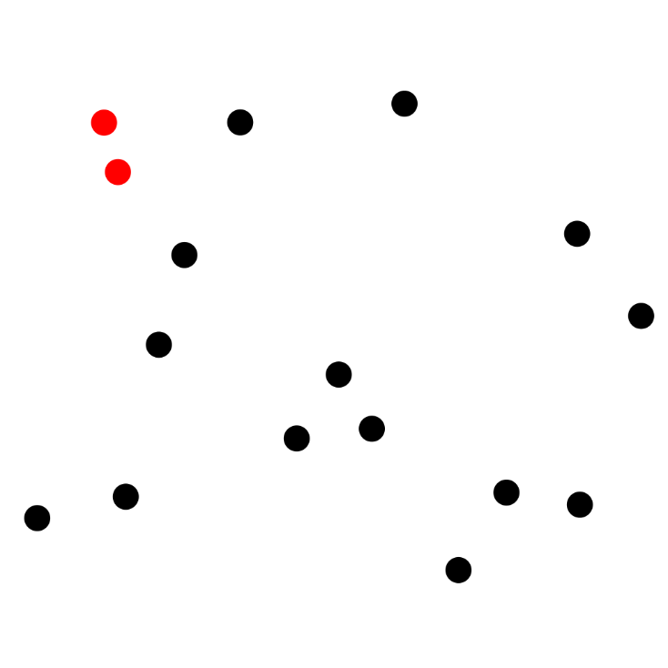
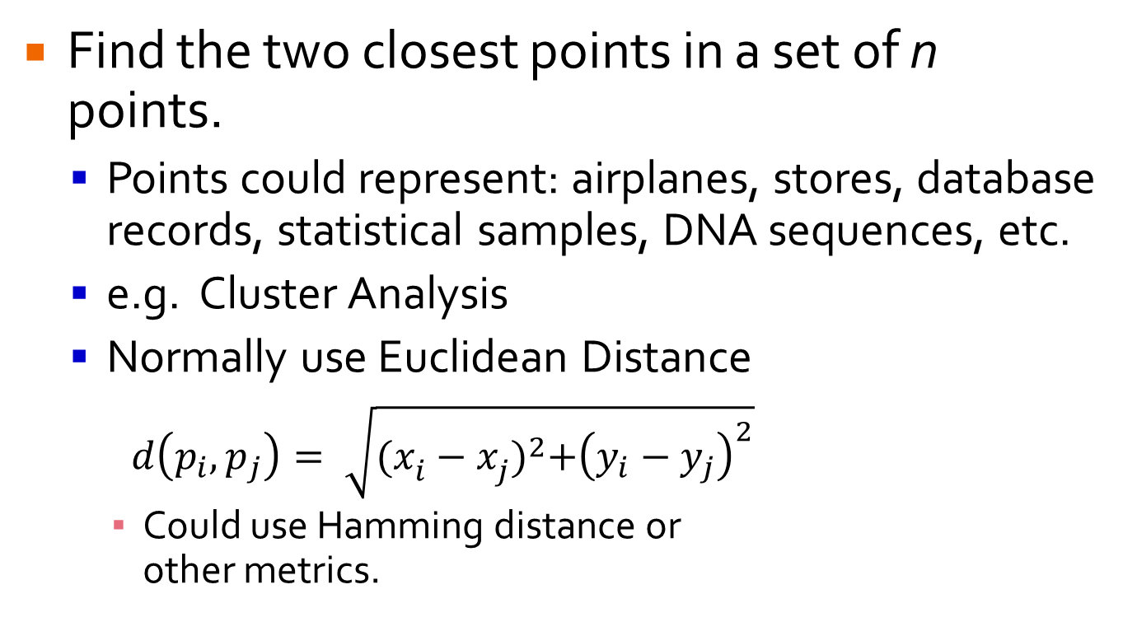
Closest Pair
Find the two closest points in a set of n points.
Points could represent: airplanes, stores, database records, statistical samples, DNA sequences, etc.
e.g. Cluster Analysis
Normally use Euclidean Distance
$d\left(p_{i},p_{j}\right)= \sqrt{{(x_{i}^{}−x_{j}^{})}^{2}+{\left(y_{i}−y_{j}\right)}^{2}}$
Could use Hamming distance or other metrics.

Slide 18
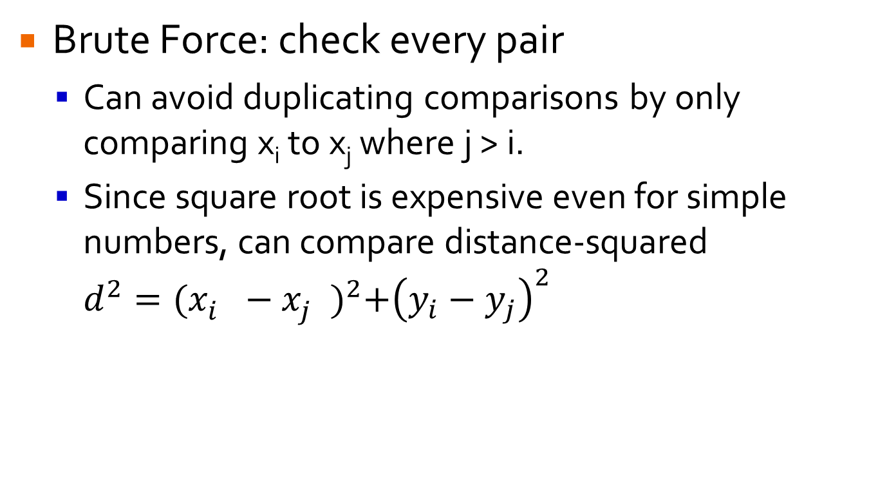
Closest Pair
Brute Force: check every pair
Can avoid duplicating comparisons by only comparing x_{i} to x_{j} where j > i.
Since square root is expensive even for simple numbers, can compare distance-squared $d^{2}={(x_{i}^{}−x_{j}^{})}^{2}+{\left(y_{i}−y_{j}\right)}^{2}$

Slide 19
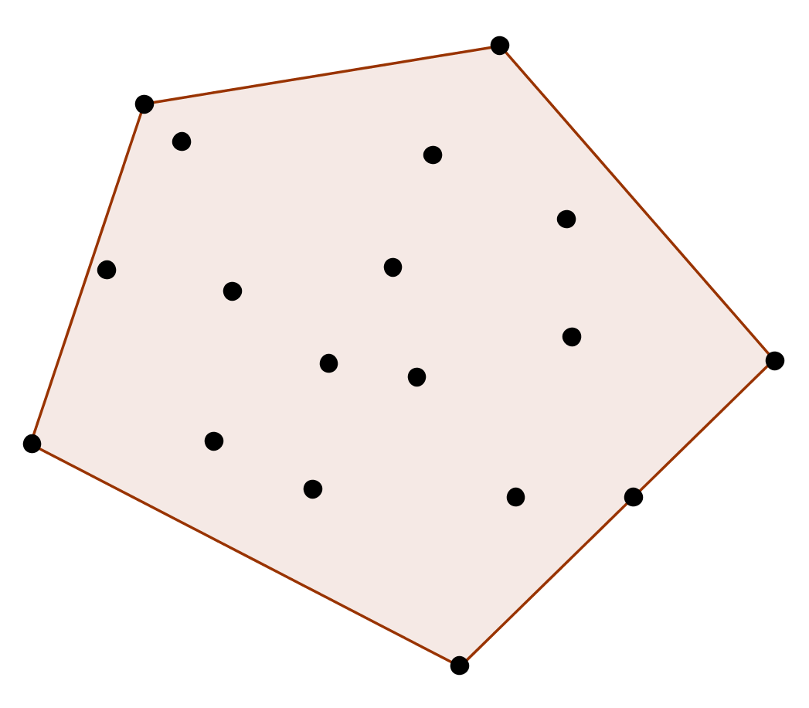
Convex Hull
Given set of points S, find the subset of S that forms a convex hull enclosing all the points in S.

Slide 20
Brute Force Convex Hull
Test each pair of points to see if line segment between them is part of convex hull.
i.e. whether all other points lie to one side of it.
Given two points (x₁,y₁) (x₂,y₂), line between them is: ax + by = c
a = y₂-y₁, b = x₁-x₂, c = x₁y₂-y₁x₂
O(n³)

Slide 21

Lab 5: Mock Interview
Work in pairs: 1 person is interviewer, 1 person is interviewee
Interviewee writes pseudo-code on the board
Interviewer asks questions to help interviewee improve their pseudo-code
Problem: Opposites Don’t Attract
You are writing an online dating match algorithm.
Notes:
Introduce Selves

Slide 22
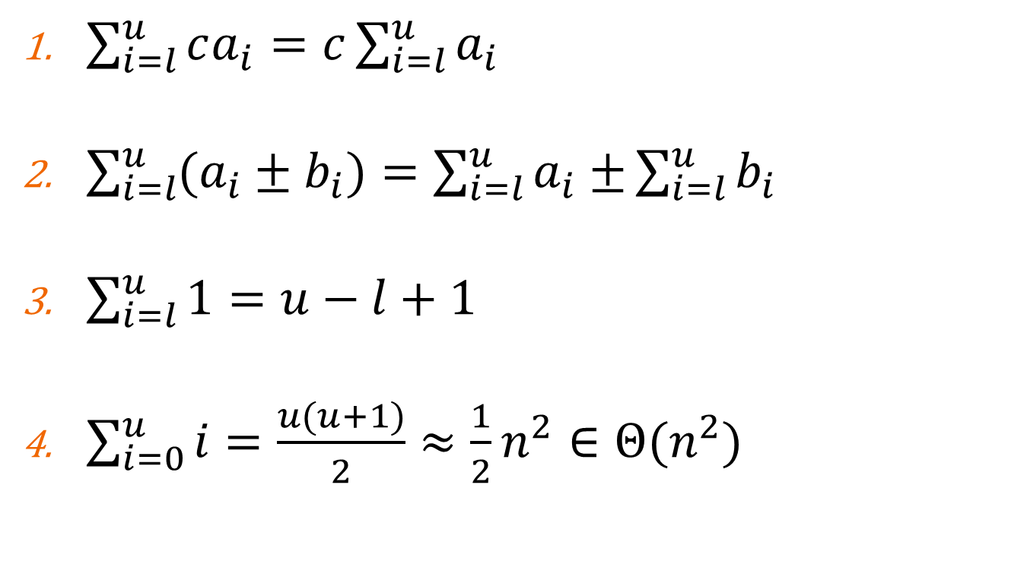
Useful Transformations
$\sum_{i=l}^{u}{ca_{i}=c\sum_{i=l}^{u}{a_{i}}}$
$\sum_{i=l}^{u}{(a_{i}±b_{i})=\sum_{i=l}^{u}{a_{i}±}}\sum_{i=l}^{u}{b_{i}}$
$\sum_{i=l}^{u}{1=u−l+1}$
$\sum_{i=0}^{u}{i=\frac{u(u+1)}{2}≈\frac{1}{2}n^{2}∈Θ(n^{2})}$

